Slide 1



OTT_Platform_Analysis
View in Power BI

Slide 2
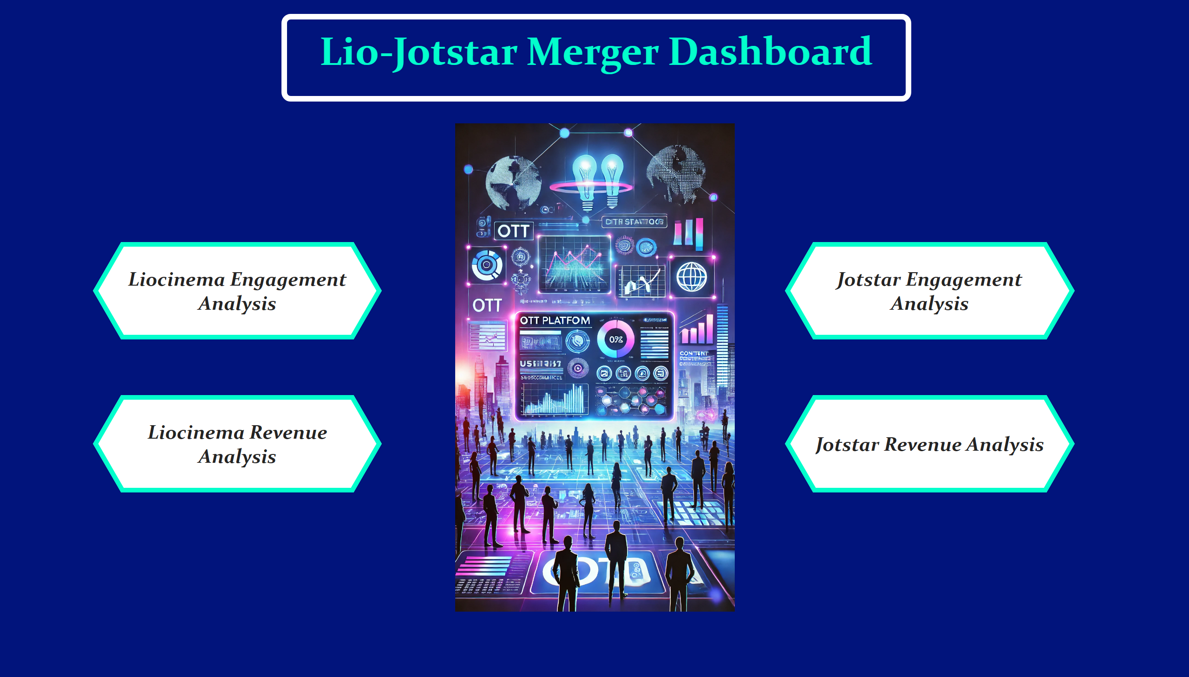
Home
Notes:
image
No alt text provided
pageNavigator
No alt text provided
pageNavigator
No alt text provided
textbox
No alt text provided

Slide 3
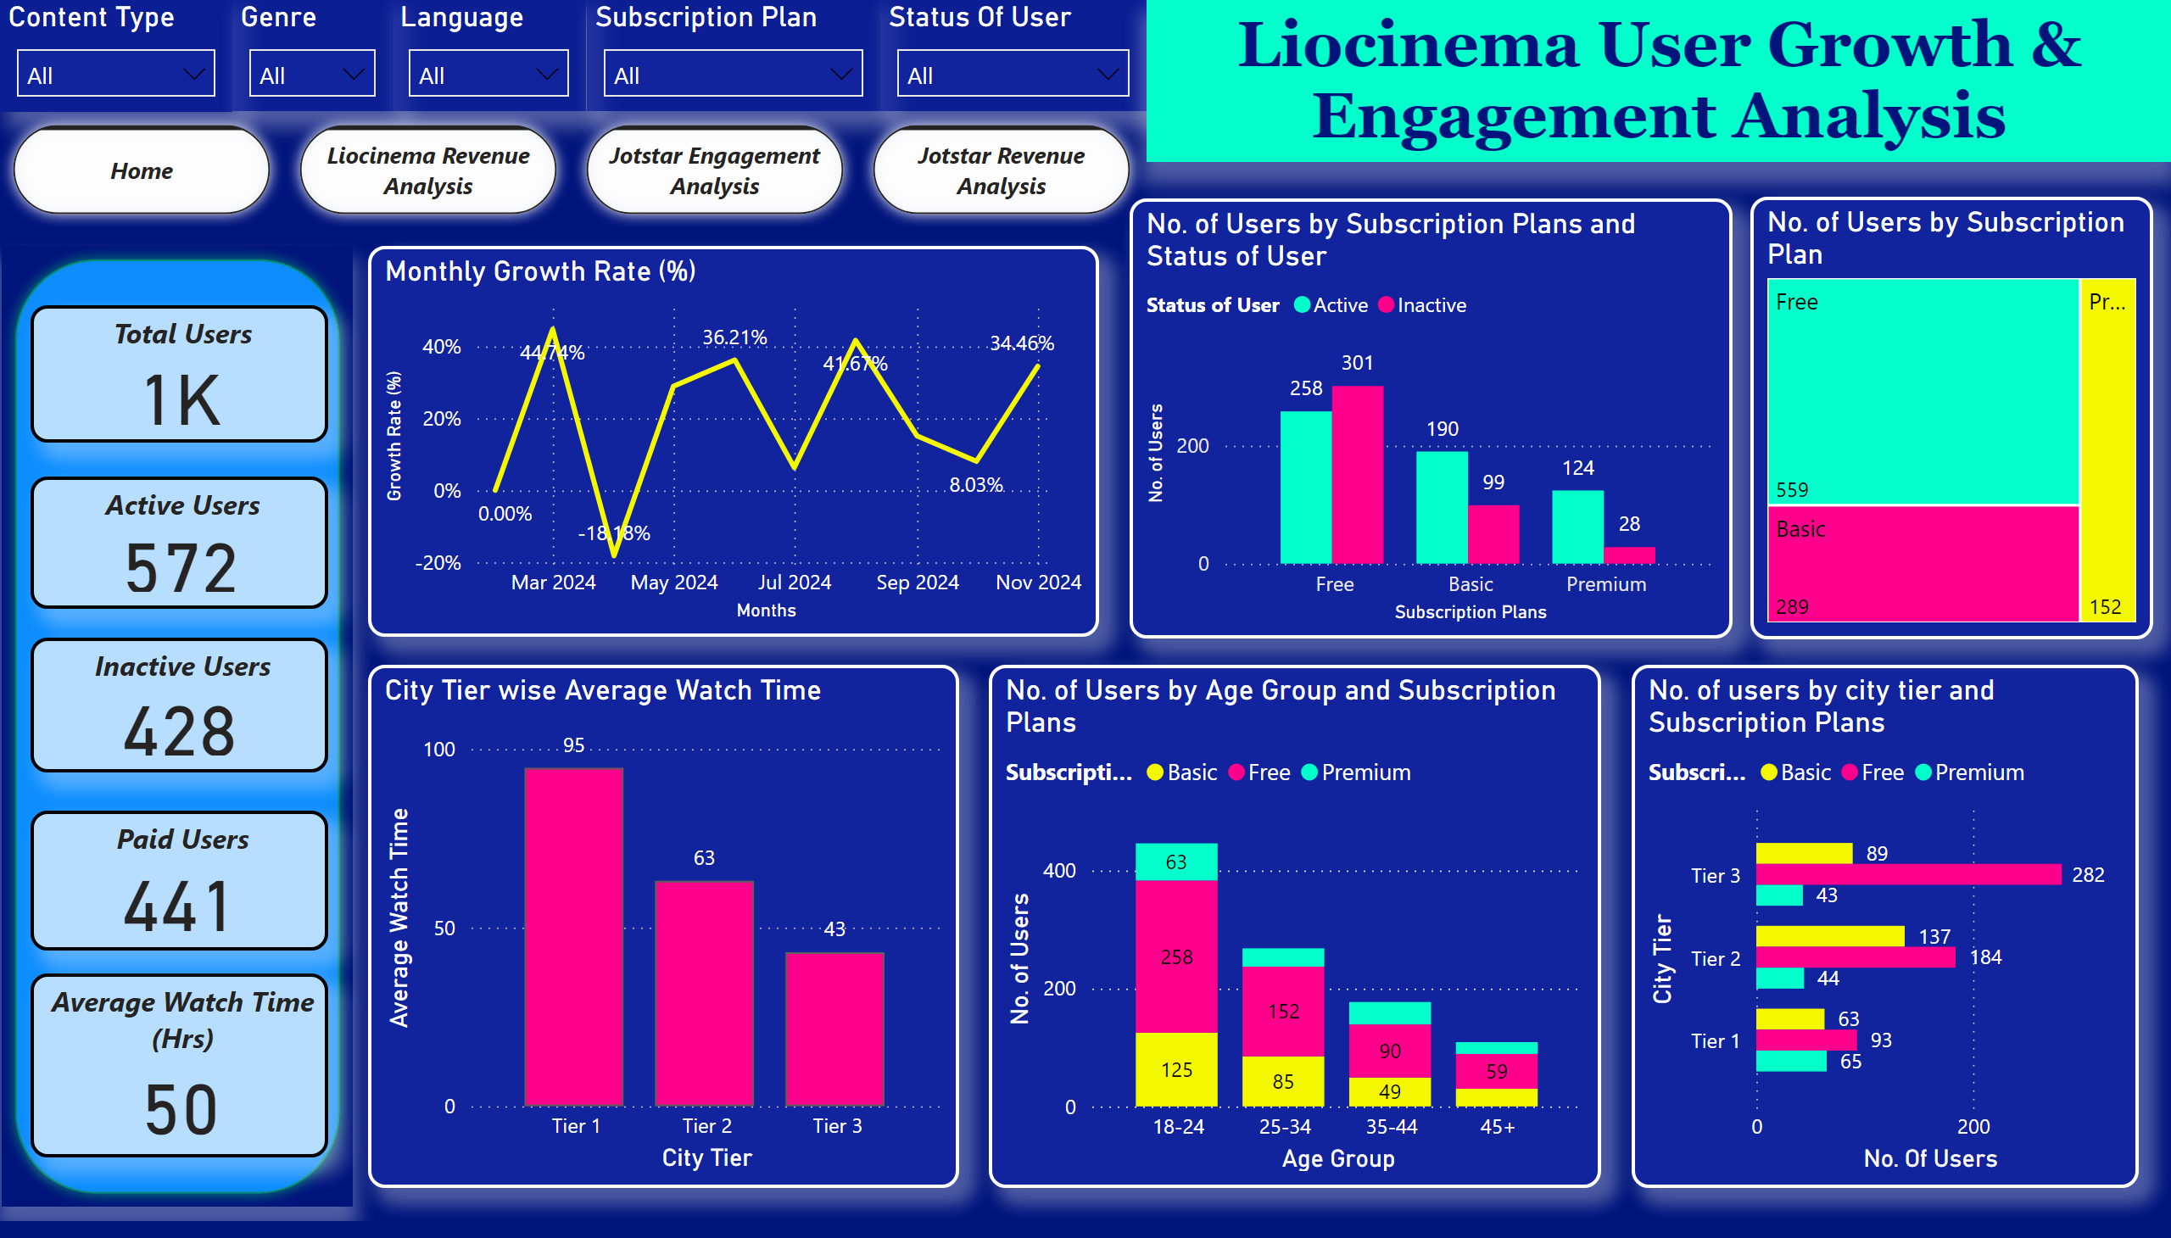
Liocinema Engagement Analysis
Notes:
Content Type
No alt text provided
Genre
No alt text provided
Language
No alt text provided
Subscription Plan
No alt text provided
Total Users
No alt text provided
Active Users
No alt text provided
Inactive Users
No alt text provided
Average Watch Time (Hrs)
No alt text provided
Monthly Growth Rate (%)
No alt text provided
No. of Users by Age Group and Subscription Plans
No alt text provided
No. of users by city tier and Subscription Plans
No alt text provided
No. of Users by Subscription Plans and Status of User
No alt text provided
City Tier wise Average Watch Time
No alt text provided
Status Of User
No alt text provided
shape
No alt text provided
textbox
No alt text provided
pageNavigator
No alt text provided
Paid Users
No alt text provided
No. of Users by Subscription Plan
No alt text provided

Slide 4
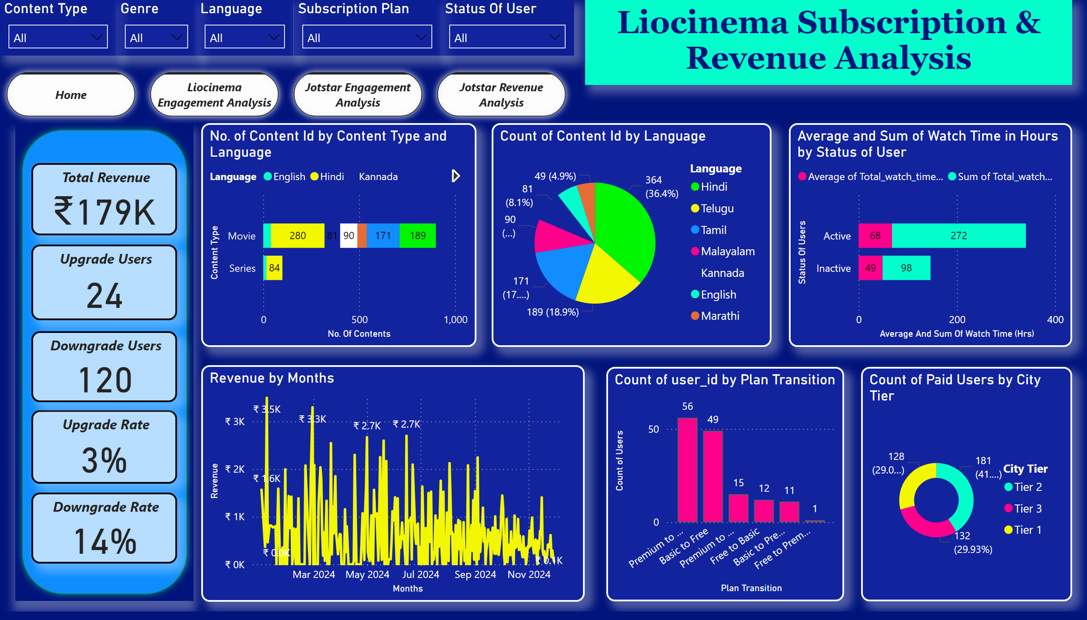
Liocinema Revenue Analysis
Notes:
No. of Content Id by Content Type and Language
No alt text provided
Count of Content Id by Language
No alt text provided
Total Revenue
No alt text provided
Upgrade Rate
No alt text provided
Downgrade Rate
No alt text provided
Upgrade Users
No alt text provided
Downgrade Users
No alt text provided
Revenue by Months
No alt text provided
shape
No alt text provided
textbox
No alt text provided
Content Type
No alt text provided
Genre
No alt text provided
Language
No alt text provided
Subscription Plan
No alt text provided
Status Of User
No alt text provided
pageNavigator
No alt text provided
Average and Sum of Watch Time in Hours by Status of User
No alt text provided
Count of Paid Users by City Tier
No alt text provided
clusteredColumnChart
No alt text provided

Slide 5
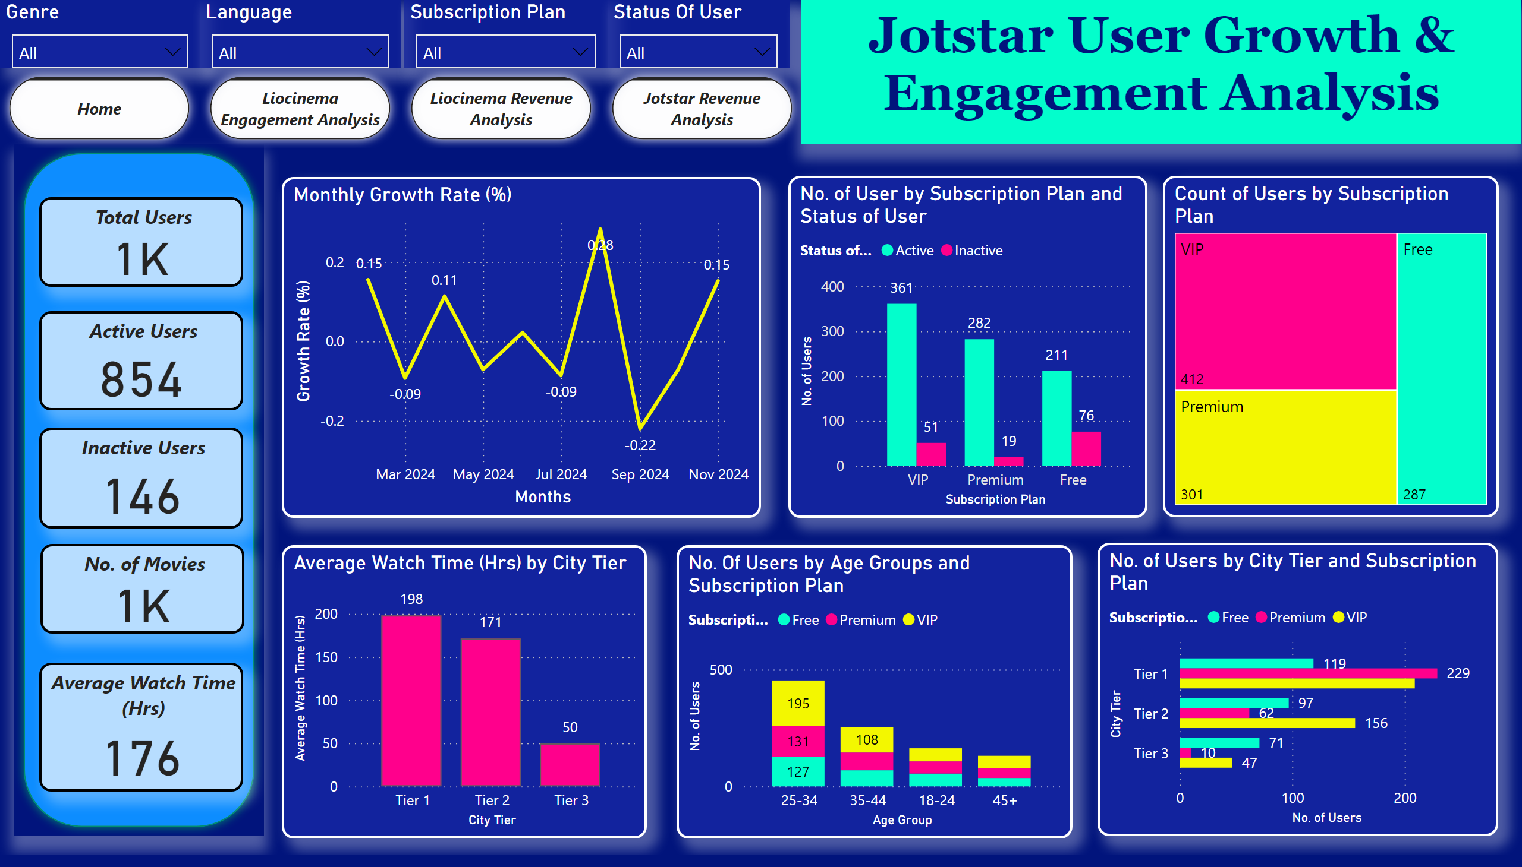
Jotstar Engagement Analysis
Notes:
Genre
No alt text provided
Language
No alt text provided
Subscription Plan
No alt text provided
Status Of User
No alt text provided
Total Users
No alt text provided
Active Users
No alt text provided
Inactive Users
No alt text provided
No. of Movies
No alt text provided
Average Watch Time (Hrs)
No alt text provided
No. of User by Subscription Plan and Status of User
No alt text provided
Average Watch Time (Hrs) by City Tier
No alt text provided
No. Of Users by Age Groups and Subscription Plan
No alt text provided
No. of Users by City Tier and Subscription Plan
No alt text provided
Monthly Growth Rate (%)
No alt text provided
shape
No alt text provided
pageNavigator
No alt text provided
textbox
No alt text provided
Count of Users by Subscription Plan
No alt text provided

Slide 6
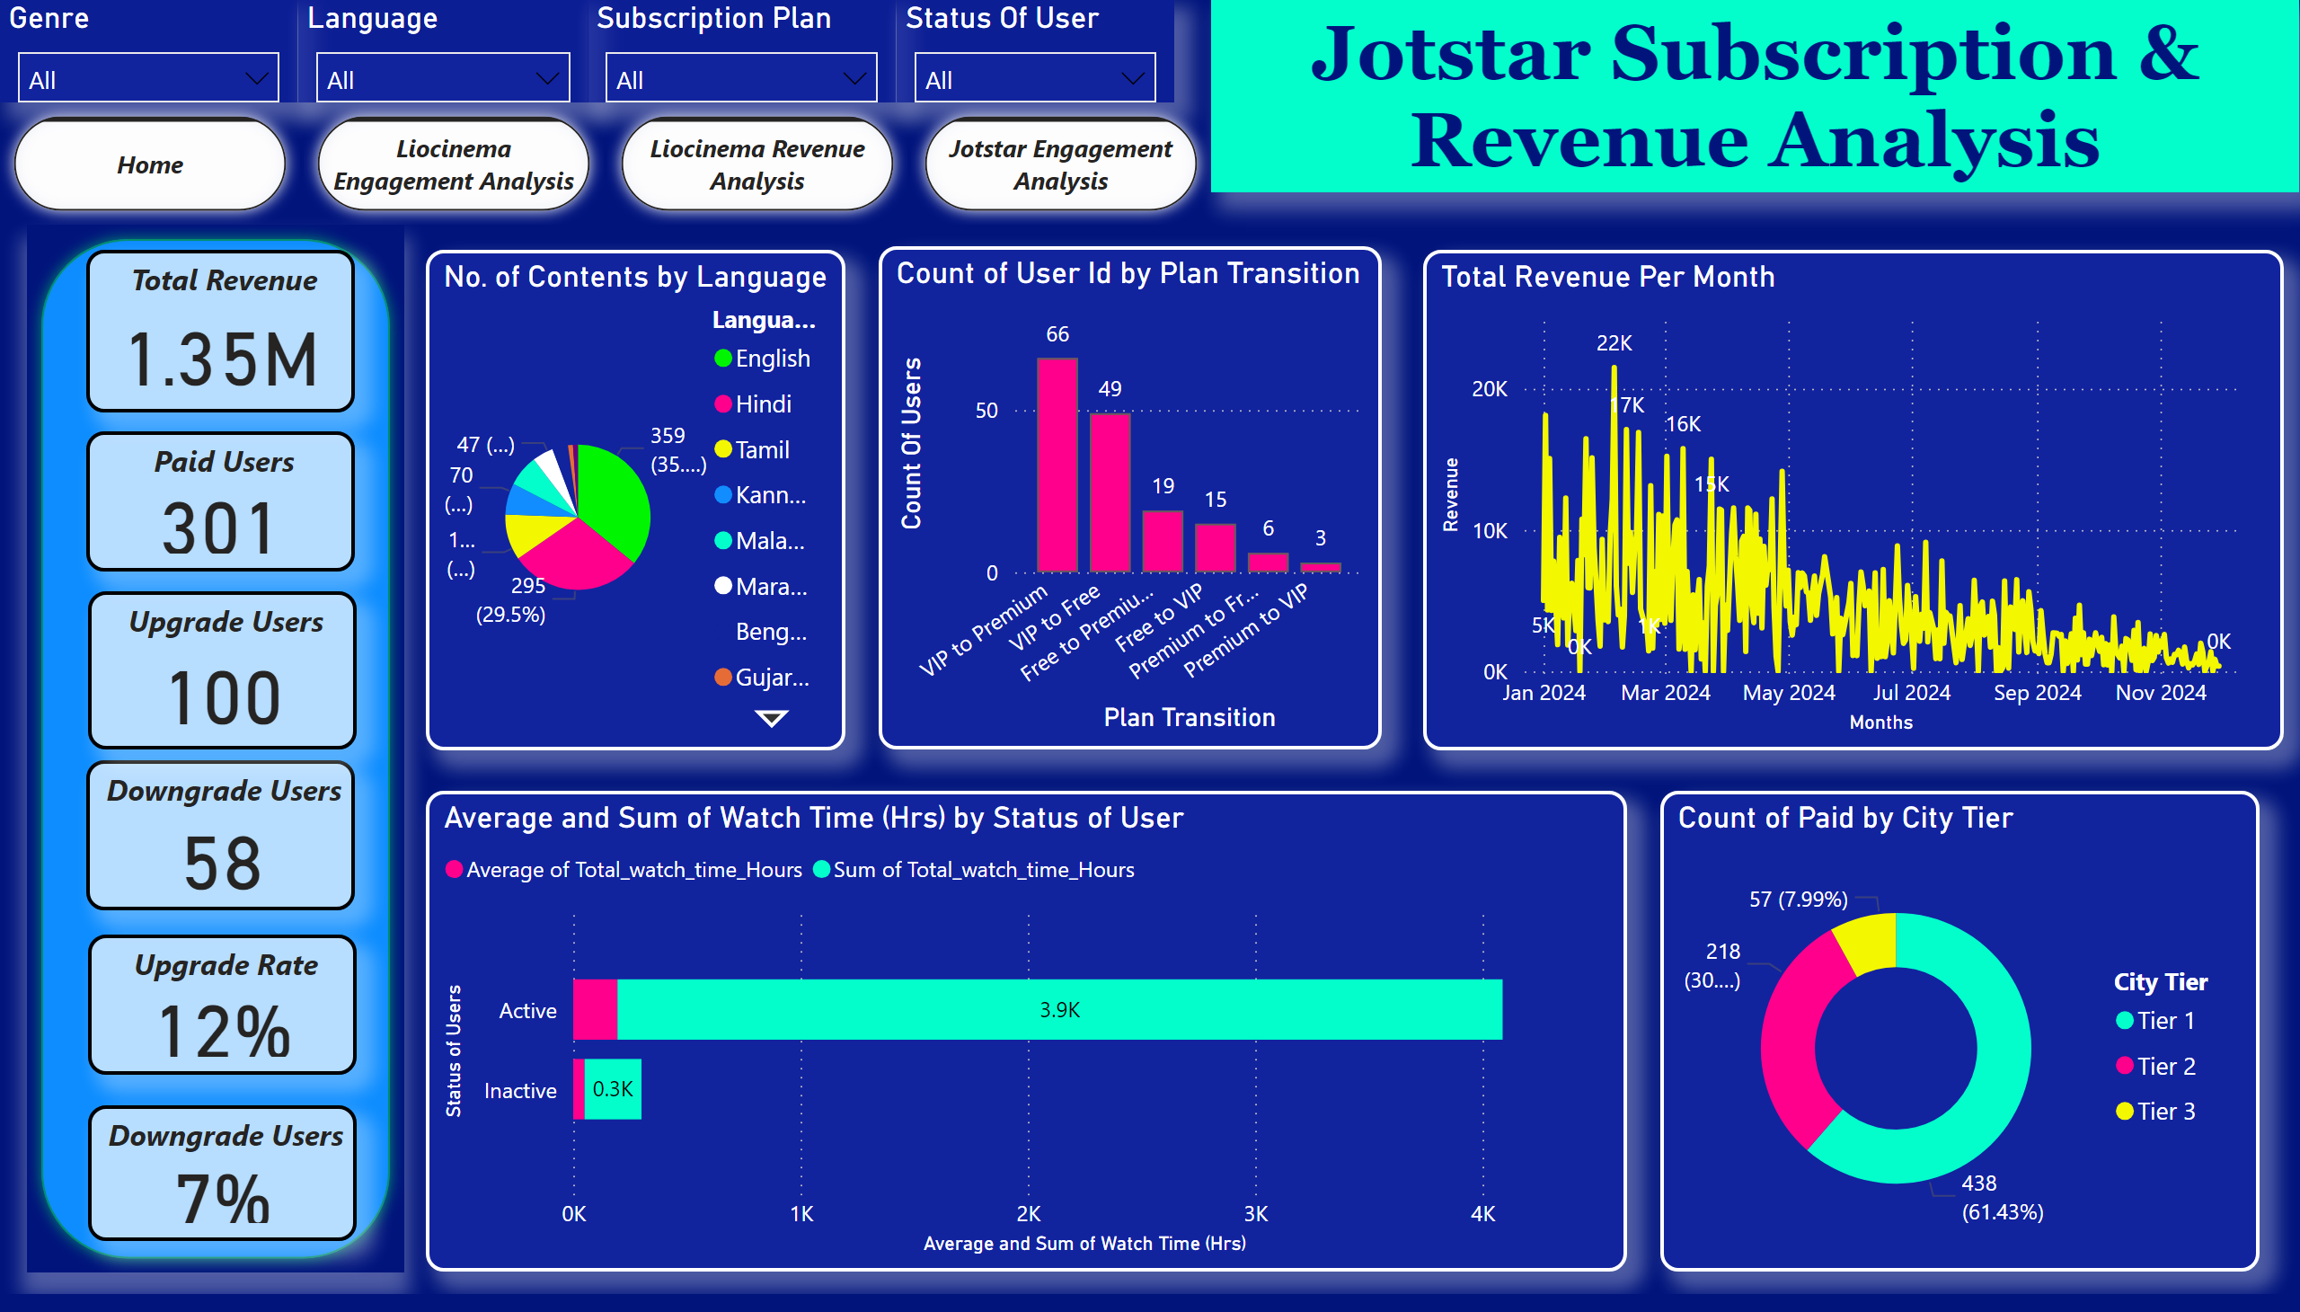
Jotstar Revenue Analysis
Notes:
Total Revenue
No alt text provided
Paid Users
No alt text provided
Downgrade Users
No alt text provided
Upgrade Users
No alt text provided
Upgrade Rate
No alt text provided
Downgrade Users
No alt text provided
Genre
No alt text provided
Language
No alt text provided
Subscription Plan
No alt text provided
Status Of User
No alt text provided
No. of Contents by Language
No alt text provided
Total Revenue Per Month
No alt text provided
shape
No alt text provided
pageNavigator
No alt text provided
textbox
No alt text provided
Count of User Id by Plan Transition
No alt text provided
Count of Paid by City Tier
No alt text provided
Average and Sum of Watch Time (Hrs) by Status of User
No alt text provided

